Slide 1
Maze Solving Using BFS&DFS
Zagazig University Faculty of engineering Computer and systems engineering Dept.

Slide 2
Project mates: Ahmed Mahmoud Ali Anas Ahmed Fouad Mahmoud El-sayed Hussien Menna-Allah Ashraff Mustafa Kamel El-sayed Sultan Ibrahim

Slide 3
Program’s two main parts:
1.GUI Coding. 2.BFS&DFS Coding.

Slide 4
First let’s see the GUI Layout:

Slide 5
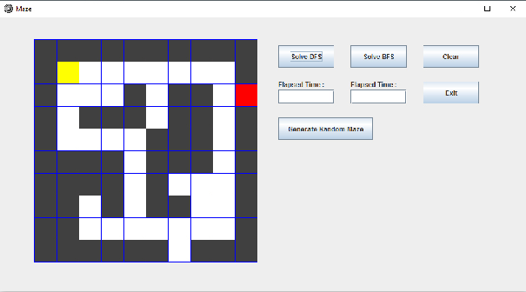
The GUI consists of:
Five buttons: 1. Solve DFS 2. Solve BFS 3. Close 4. Exit 5. Generate random maze Two text box: Elapsed time for both dfs & bfs.

Slide 6
Cont.The GUI consists of:
Yellow: initial position.
Red: goal.
Green: explored nodes.
White: Permitted moves.
black : not permitted moves.

Slide 7
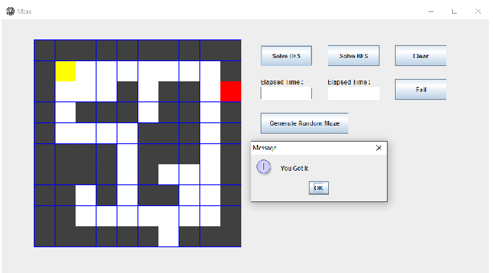
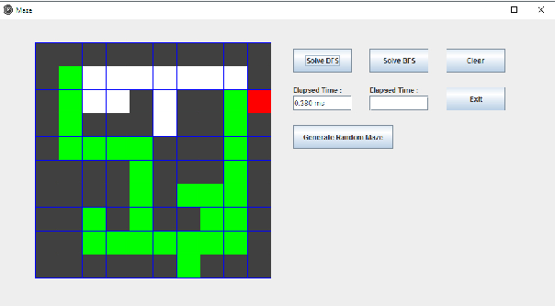
First try to solve using DFS:
YOU GOT IT! : means you successfully solve the maze .
Elapsed time: 0.380

Slide 8
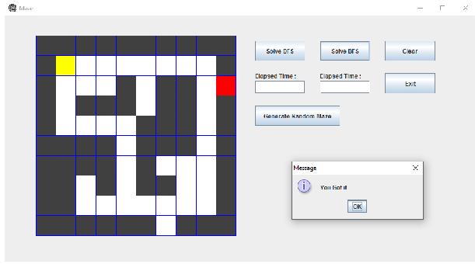
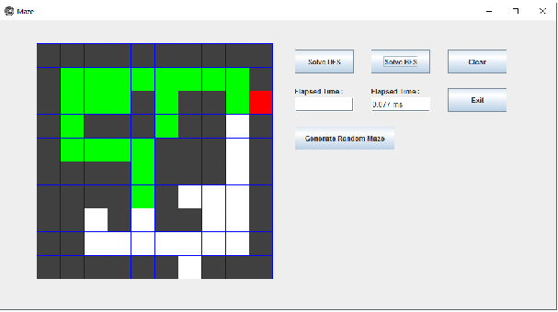
Then solve Using BFS:
Same as previous, just tap the SOLVE BFS button and let the algorithm solve it!
Elapsed time: 0.077
Notice that BFS is FASTER than DFS!! (in this specific maze)

Slide 9
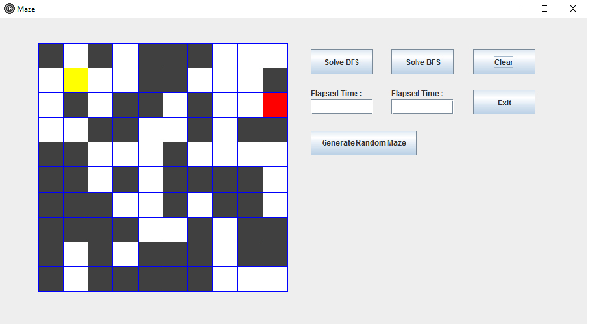
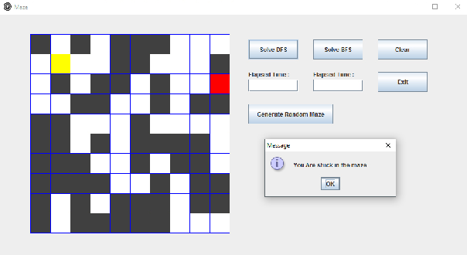
Then, solve random maze:
Tap generate random maze button!
Then a maze is generated which may or may not be solvable .
Obviously this maze can’t be solved nither by BFS nor by DFS!!

Slide 10
Finally the coding!!

